Slide 1
Insertion Sort
Muhaimin Bin Munir

Slide 2
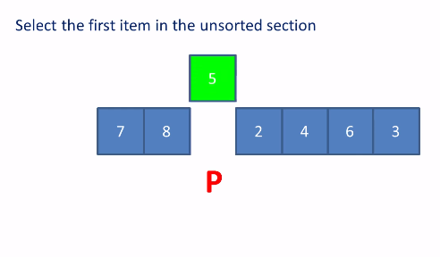
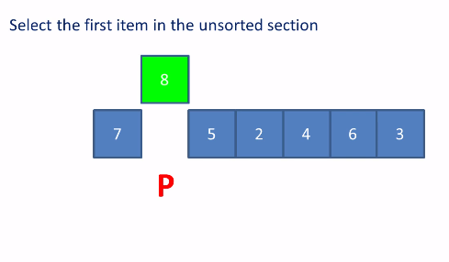
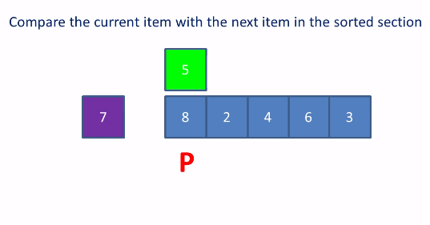
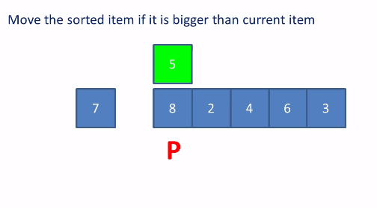
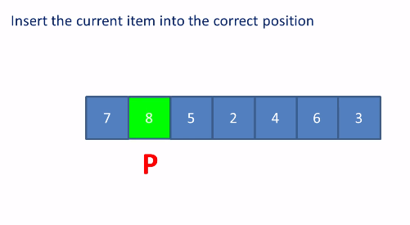
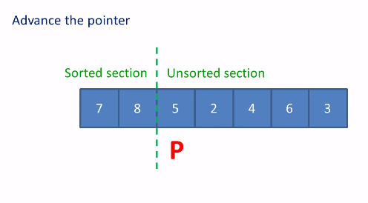
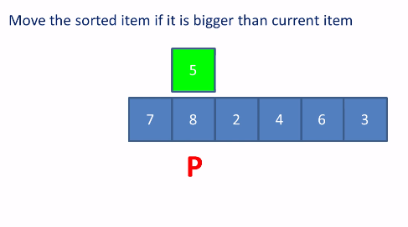
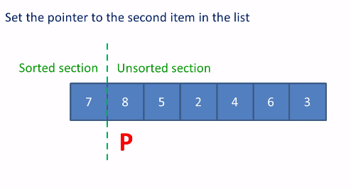
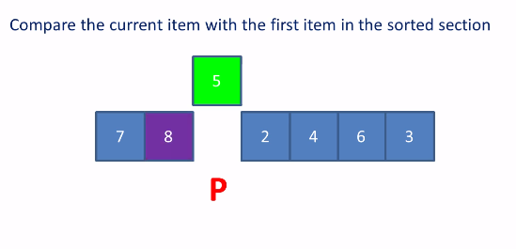
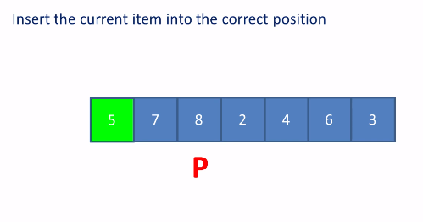
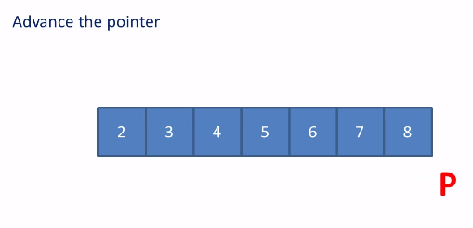
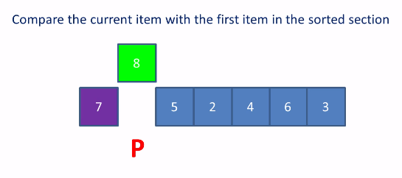

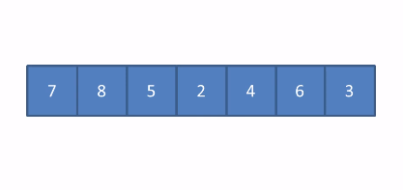
Insertion Sort - Simulation
Notes:
Reference: https://www.youtube.com/watch?v=TPyJ0k8y3Nc

Slide 3
Pseudocode
INSERTION-SORT(A)
1 for j ← 2 to length[A] 2 do key ← A[j] 3 ▹ Insert A[j] into the sorted sequence A[1 j - 1]. 4 i ← j - 1 5 while i > 0 and A[i] > key 6 do A[i + 1] ← A[i] 7 i ← i - 1 8 A[i + 1] ← key
Notes:
Reference: CLRS

Slide 4
Correctness
Loop Invariant
We use loop invariants to help us understand why an algorithm is correct. We must show three things about a loop invariant:
Initialization: It is true prior to the first iteration of the loop.
Maintenance: If it is true before an iteration of the loop, it remains true before the next iteration.
Termination: When the loop terminates, the invariant gives us a useful property that helps show that the algorithm is correct.
Notes:
Invariant: a function, quantity, or property which remains unchanged when a specified transformation is applied.
Loop Invariant: In computer science, a loop invariant is a property of a program loop that is true before each iteration.

Slide 5
Insertion Sort - Correctness
Initialization
We start by showing that the loop invariant holds before the first loop iteration, when j = 2. The subarray A[1 ….. j - 1], therefore, consists of just the single element A[1], which is in fact the original element in A[1]. Moreover, this subarray is sorted (trivially, of course), which shows that the loop invariant holds prior to the first iteration of the loop.

Slide 6
Insertion Sort - Correctness
Maintenance
Next, we tackle the maintenance property: showing that each iteration maintains the loop invariant. Informally, the body of the outer for loop works by moving A[j - 1], A[ j - 2 ], A[ j - 3 ], and so on by one position to the right until the proper position for A[ j ] is found (lines 4-7), at which point the value of A[ j ] is inserted (line 8). A more formal treatment of the second property would require us to state and show a loop invariant for the "inner" while loop. But for now, we rely on our informal analysis to show that the second property holds for the outer loop.

Slide 7
Insertion Sort - Correctness
Termination
Finally, we examine what happens when the loop terminates. For insertion sort, the outer for loop ends when j exceeds n, i.e., when j = n + 1. Substituting n + 1 for j in the wording of loop invariant, we have that the subarray A[1 …. n] consists of the elements originally in A[1 …. n], but in sorted order. But the subarray A[1 …. n] is the entire array! Hence, the entire array is sorted, which means that the algorithm is correct.

Slide 8
664,728
Population of Khulna
Notes:
Upto 2011

Slide 9
Adios… but let’s code before we leave.

